Slide 1
Abstract Data Type

Slide 2
Abstract Data Types
In Object Oriented Programming, data and the operations that manipulate that data are grouped together in classes
Abstract Data Types (ADTs) store data and allow various operations on the data to access and change it

Slide 3
Abstract Data Types
An abstract data type (ADT) is a model of a data structure that specifies:
the characteristics of the collection of data
the operations that can be performed on the collection
It’s abstract because it doesn’t specify how the ADT will be implemented.
A given ADT can have multiple implementations

Slide 4
Why Abstract Data Type?
Specify the operations of the data structure and leave implementation details to later
in Java use an interface to specify operations
many, many different ADTs
picking the right one for the job is an important step in design
"Get your data structures correct first, and the rest of the program will write itself."
High level languages often provide built in ADTs,
the C++ STL, the Java standard library

Slide 5
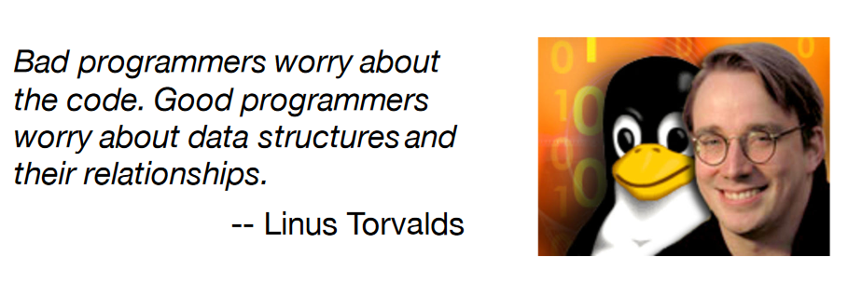
Why we need Data Abstractions (ADTs)

Slide 6
Why we need Data Abstractions (ADTs)
Organizing and manipulating data is pervasive
inventing and describing algorithms is less common
Often best to start your design by designing data structures
how will relevant data be organized
what operations will be permitted on the data by clients

Slide 7
The Core Operations
Every Collection ADT should provide a way to:
add an item
remove an item
find, retrieve, or access an item
Many, many more possibilities
is the collection empty
make the collection empty
give me a sub set of the collection
and on and on and on…
Many different ways to implement these items each with associated costs and benefits

Slide 8
Implementing ADTs
when implementing an ADT the operations and behaviors are already specified
Java interface
Implementer’s first choice is what to use as the internal storage container for the concrete data type
the internal storage container is used to hold the items in the collection
often an implementation of an ADT
initially slim pickings for choice of storage containers: arrays anyone?

Slide 9
Example: Bag
Simplest ADT is a Bag
items can be added, removed, accessed
no implied order to the items
duplicates allowed
A bag is just a container for a group of data items.
analogy: a bag of candy
The positions of the data items don’t matter (unlike a list).
{3, 2, 10, 6} is equivalent to {2, 3, 6, 10}
The items do not need to be unique (unlike a set).
{7, 2, 10, 7, 5} isn’t a set, but it is a bag

Slide 10
Example: Bag
The operations supported by our Bag ADT:
add(item) : add item to the Bag
remove(item) : remove one occurrence of item (if any) from the Bag
contains(item) : check if item is in the Bag
numItems() : get the number of items in the Bag
grab() : get an item at random, without removing it
reflects the fact that the items don’t have a position (and thus we can’t say "get the 5th item in the Bag")
toArray() : get an array containing the current contents of the bag
Note that we don’t specify how the bag will be implemented

Slide 11
Specifying an ADT Using an Interface
In Java, we can use an interface to specify an ADT:
public interface Bag {
boolean add(Object item);
boolean remove(Object item);
boolean contains(Object item);
int numItems();
Object grab();
Object[] toArray();
}
An interface specifies a set of methods.
Includes only the method headers
Cannot include the actual method definitions

Slide 12
Implementing an ADT Using a Class
To implement an ADT, we define a class:
public class MyBag implements Bag
{
private List<Object> items;
private int numItems;
...
public boolean add(Object item) {
...
}
When a class header includes an implements clause, the class must define all of the methods in the interface.

Slide 13
Encapsulation
Our implementation provides proper encapsulation
a key principle of object-oriented programming
The data and the operations on them are tied together
Used to hide the values or state of a structured data object inside a class (information hiding)
We prevent direct access to the internals of an object by making its fields private.
We provide limited indirect access through methods that are labeled

Slide 14
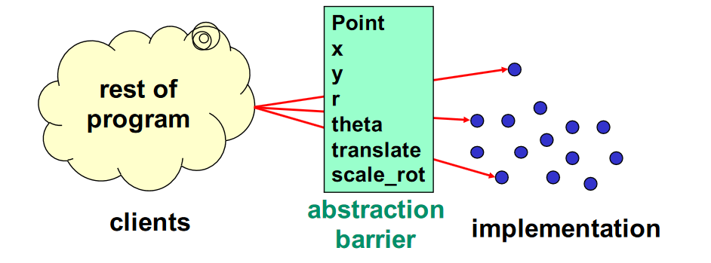
Abstract data type = objects + operations
Implementation is hidden
The only operations on objects are those provided by the abstraction

Slide 15
Contracts
Every ADT should have a contract (or specification) that:
Specifies the set of valid values of the ADT
Specifies, for each operation of the ADT:
Its name
Its parameter types
Its result type, if any
Its observable behavior
Does not specify:
The data representation
The algorithms used to implement the operations

Slide 16
Importance of the contract
A contract is an agreement between two parties; in this case
The developer of the ADT, who is concerned with making the operations correct and efficient
The client, who just wants to use the ADT to get a job done
It doesn’t matter if you are both of these parties; the contract is still essential for good code
This separation of concerns is essential in any large project

Slide 17
Promise no more than necessary
For a general API, the developer should provide as much generality as feasible
But for a specific program, the class author should provide only what is essential at the moment
Do not overthink, do one task well
Your documentation should not expose anything that the application programmer does not need to know
If you design for generality, it’s easy to add functionality later—but removing it may have serious consequences

Slide 18
Benefits of ADTs
If clients “respect” or “are forced to respect” data abstractions...
For example, “it’s a Bag with these operations...”
Can delay decisions on how ADT is implemented
Can fix bugs by changing how ADT is implemented
Can change algorithms
For performance
In general or in specialized situations
Can be reused in future programs

